Slide 1
Programming the RPi & Python Primer
With help from
https://lobster1234.github.io/2017/05/25/python-java-primer/

Slide 2
Programming the RPi
By default, supporting Python as the educational language
Any language which will compile for ARMv6 can be used with the Raspberry Pi
For primary age SCRATCH game maker is bundled
Raspbian also contains Java SE platform

Slide 3

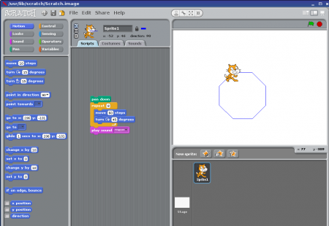
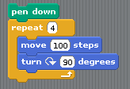
Programming – SCRATCH
scratch is free from MIT

Slide 4
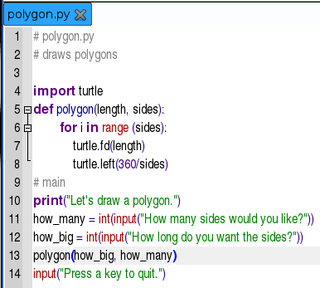
Programming – Python

Slide 5
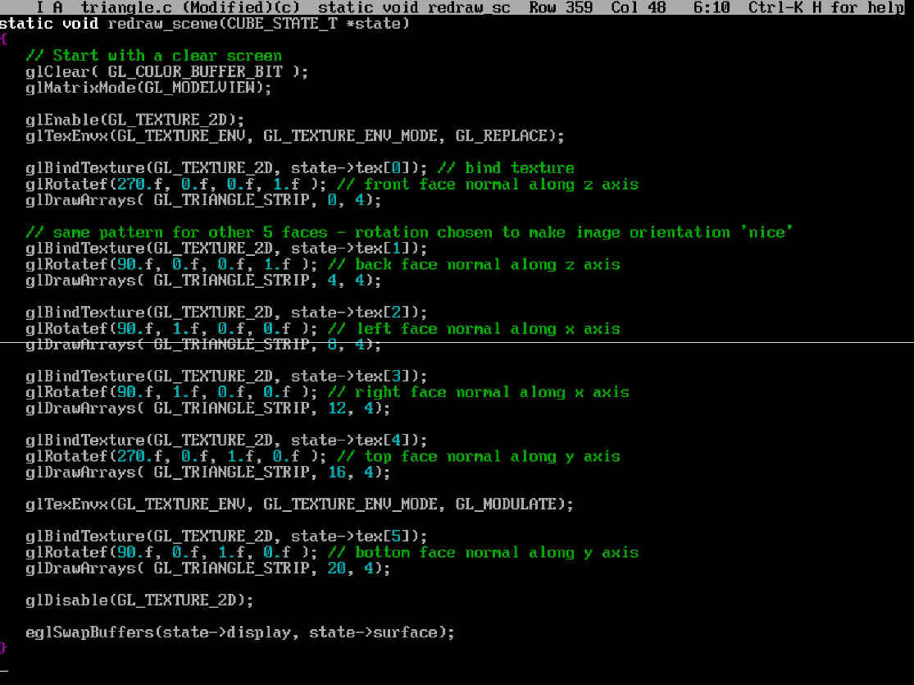
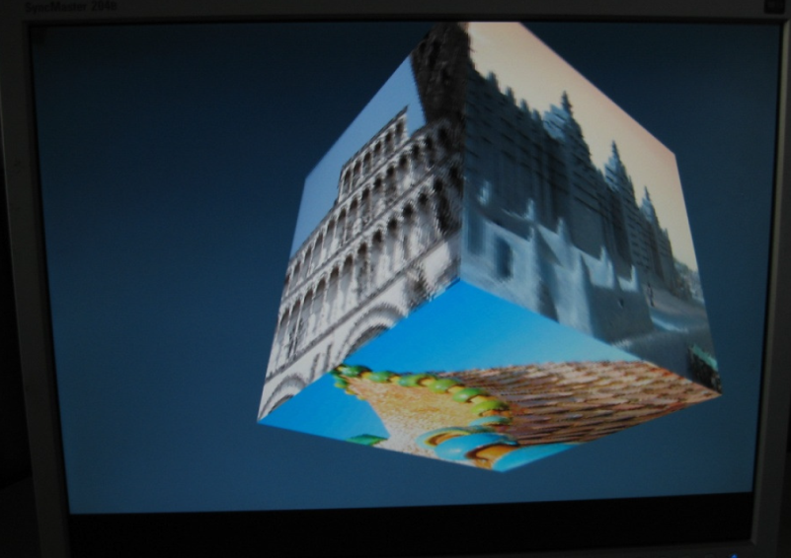
Programming - OpenGL
Raspberry Pi incorporates a powerful graphics accelerator – OpenGL
Examples, including Quake 3 at
https://github.com/raspberrypi/quake3

Slide 6
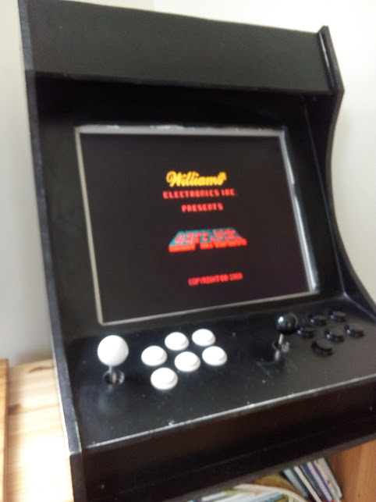
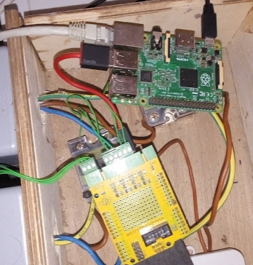
Some Other Things
Can run Kodi software
Turn your TV into a Smart TV!
Emulators for tons of old platforms (C64, Atari, NES, etc.)
I have a mame emulator.
Brew your own beer!
I've been doing this with the help of an RPi since 2014
Has its own app store
http://store.raspberrypi.com/

Slide 7
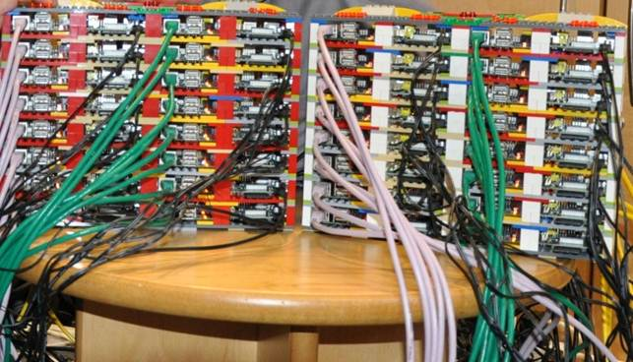
Projects Using Raspberry Pi
Raspberry Pi Cluster
https://arstechnica.com/information-technology/2012/09/university-builds-cheap-supercomputer-with-raspberry-pi-and-legos/
http://www.youtube.com/watch?v=Jq5nrHz9I94

Slide 8
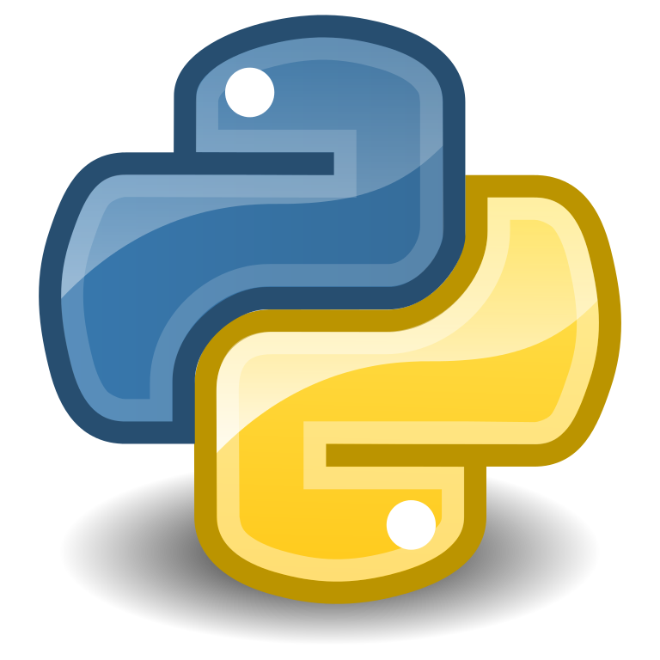
What’s Python
Created 1991
Used for Web Dev, Software Dev, Maths, Embedded Devices (micro python), Scripting
Why Python
Works on many platforms
Easy to learn(simple syntax)
One thing to always remember about Python:
Relies on indentation(using white space) to define scope for if statements, loops, functions. Java uses curly-brackets for this.

Slide 9
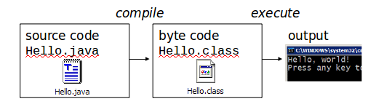
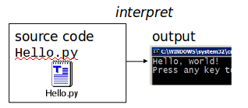
Python is interpreted
Many languages require compilation of program to a form the machine understands
Python is interpreted directly to machine instructions

Slide 10
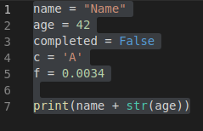
Variables

Slide 11

Read Input

Slide 12
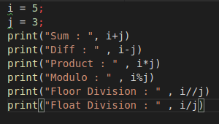

Operators

Slide 13
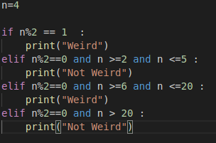
If-then-else

Slide 14
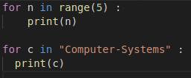
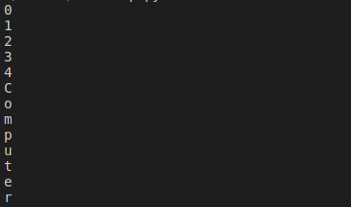
For loop

Slide 15
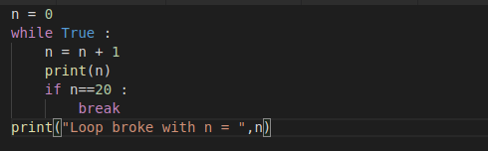
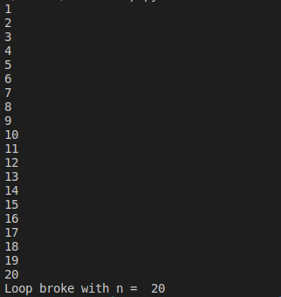
While loop

Slide 16
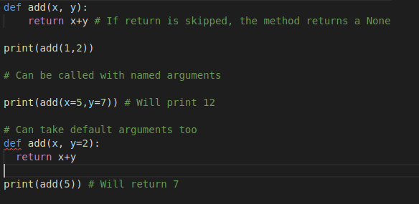
Functions

Slide 17
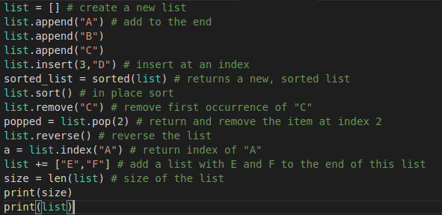
Lists

